Slide 1
Energy Efficient Cloud Computing
Zhaolin Qiu

Slide 2
01
Energy Consumption
02
Hardware Approach
03
Other Approaches
04
Reference

Slide 3
Why do we need energy-efficient cloud computing
01

Slide 4
Sharp Increase in Data Center Demand
Data center deployment has becoming a significant part of the electricity demand growth
Greatly driven by the new AI services (espeically Generative AIs)
Data centers could consume up to 9% of U.S. electricity generation annually (about 400 TerraWh) by 2030

Slide 5
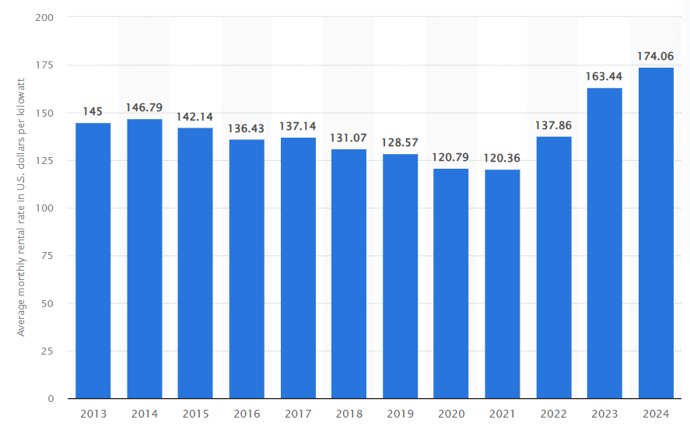
Sharp Increase in Data Center Demand
Avg. monthly rental rate of data centers in dollars/kW
Price in 2022 adjusted by inflation: $145.88
Real price of data center rentals increases by 20% from 2022 to 2024

Slide 6
Hardware Approaches
02

Slide 7
Hardware Accelerator
They are dedicated hardwares that are much more energy-efficient than CPUs/GPUs
ASIC
FPGA
In-Memory Computing

Slide 8
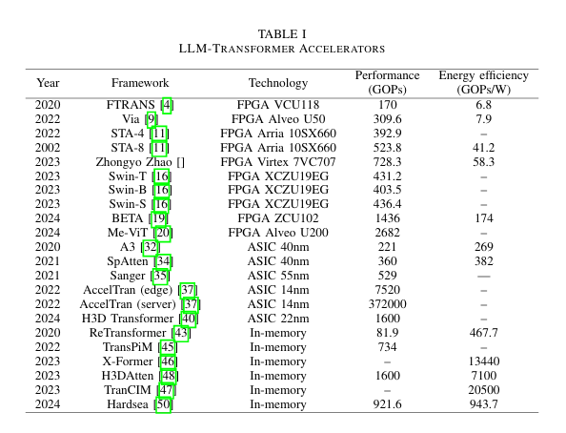
ASIC
Best Performace
Lack of flexibility (AI tech evoloves very quickly)
Release of chatGPT-3: Nov. 2022
Release of chatGPT-01: Sept. 2024
In less than 2 years chatGPT improves greatly
Expensive

Slide 9
ASIC
Open Question - Already Integrated into GPUs?
Modern Nvidia GPUs (especially those designed for AIs - A100) have specialized hardware components to accelerate neural network calculations.
Isn’t it a speical form of ASIC?

Slide 10
FPGA
Flexibility
Suitbale for edge applications
Easier Development Compared to ASIC
Harder Development Compared to PyTorch
Lack of performance (For very large models)
(parameters increases greatly)
It is becoming more difficult for FPGAs to keep up
with the performance requirement

Slide 11
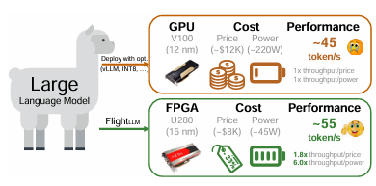
FPGA
FlightLLM (published early this year)
Achieved a better performance than V100
But on the other hand
V100 was released in 2017
A100 is 2-3 times faster than V100
Advantage range becomes small

Slide 12
In-memory Computing
Outstanding Enengy Efficiency
Immaturity
In-memory computing for large loads is still under research, not ready for industry Shows a great potential

Slide 13
Hardware Accelators
CPU/GPU/TPU are still dominating the market. The use of hardware accelerators is increasing FPGA is the most widely used accelerator technology.
The major pressure is from Nvidia that the new GPUs are utilizaing the strength of ASIC and FPGA

Slide 14
Other Approaches
02

Slide 15
Edge Computing
Distribute the workload and process data locally.
Relieve cloud datacenters of fragmented computational demands.
Reduce traffic of core network
Exampe: Autonomous Vehicles
Edge: Process data and make decisions in vehicle.
Reduces lantency, cloud pressure and increases reliability
Cloud: Aggregated driving data is sent to the cloud for updates to AI models

Slide 16
Internet of Things (IoT)
A realization of edge-cloud computing.
Process data locally or at the edge, sending only essential data to the cloud
Exampes: Smart Cities, Industrial IoT

Slide 17
Software Optimization
Optimize Workflow Scheduling (Important in IoT environment)
Involve diverse devices, and massive data streams
An efficient algorithm to balance and address various needs of IoT devices

Slide 18
Reference
[1] U.S. Department of Energy, "Clean Energy Resources to Meet Data Center Electricity Demand,"Energy.gov,[Online].Available:https://www.energy.gov/policy/articles/clean-energy-resources-meet-data-center-electricity-demand.
[2] “U.S. Data center rental rate 2024 | Statista,” Statista, 2024. https://www.statista.com/statistics/1370191/data-center-rental-rate-us/ (accessed Nov., 2024).
[3] Bureau of Labor Statistics, “CPI Inflation Calculator,” Bls.gov, 2024. https://data.bls.gov/cgi-bin/cpicalc.pl
[4] H. Wang, Y. Bai, J. Yu, and K. Wang, “TransFRU: Efficient Deployment of Transformers on FPGA with Full Resource Utilization,” Jan. 2024, doi: https://doi.org/10.1109/asp-dac58780.2024.10473976.
[5] K. Ovtcharov, O. Ruwase, J.-Y. Kim, J. Fowers, K. Strauss, and E. Chung, “Accelerating Deep Convolutional Neural Networks Using Specialized Hardware,” 2015. Available: https://www.microsoft.com/en-us/research/wp-content/uploads/2016/02/CNN20Whitepaper.pdf

Slide 19
Reference
[6] N. Koilia and C. Kachris, “Hardware Acceleration of LLMs: A comprehensive survey and comparison,” arXiv.org, 2024. https://arxiv.org/abs/2409.03384 (accessed Nov, 2024)
[7] Beakal Gizachew Assefa and Oznur Ozkasap, “A survey of energy efficiency in SDN: Software-based methods and optimization models,” vol. 137, pp. 127–143, Jul. 2019, doi: https://doi.org/10.1016/j.jnca.2019.04.001.
[8] K. Zhu, Z. Zhang, Sherali Zeadally, and F. Sun, “Learning to Optimize Workflow Scheduling for an Edge - Cloud Computing Environment,” IEEE Transactions on C loud Computing, vol. 12, no. 3, pp. 897-912, May 2024, doi: https://doi.org/10.110 9/tcc.2024.3408006.
[9] S. Zeng et al., “FlightLLM: Efficient Large Language Model Inference with a Complete Mapping Flow on FPGAs,” arXiv.org, 2024. https://arxiv.org/abs/2401.03868 (accessed Nov, 2024).

Slide 20
THANK YOU

